Slide 1

Islamic University of Technology
Course no: Phy 4143
Course Title: Physics II
Course Teacher : Dr Md. Sahab Uddin
Professor

Slide 2
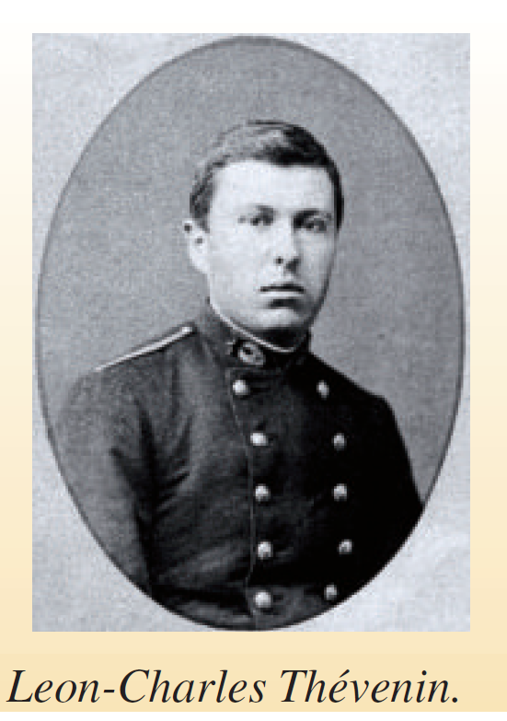
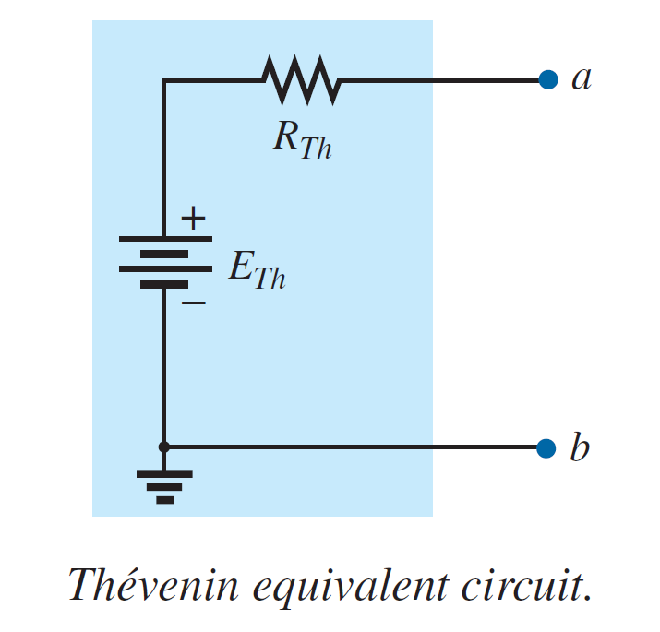
Thevenin's Theorem
Thevenin's theorem, is probably one of the most interesting in that it permits the reduction of complex networks to a simpler form for analysis and design.
Thevenin’s theorem states that a linear two-terminal circuit can be replaced by an equivalent circuit consisting of a voltage source V_{Th} in series with a resistor R_{Th}, where V_{Th} is the open-circuit voltage at the terminals and R_{Th} is the input or equivalent resistance at the terminals when the independent sources are turned off.
1883

Slide 3
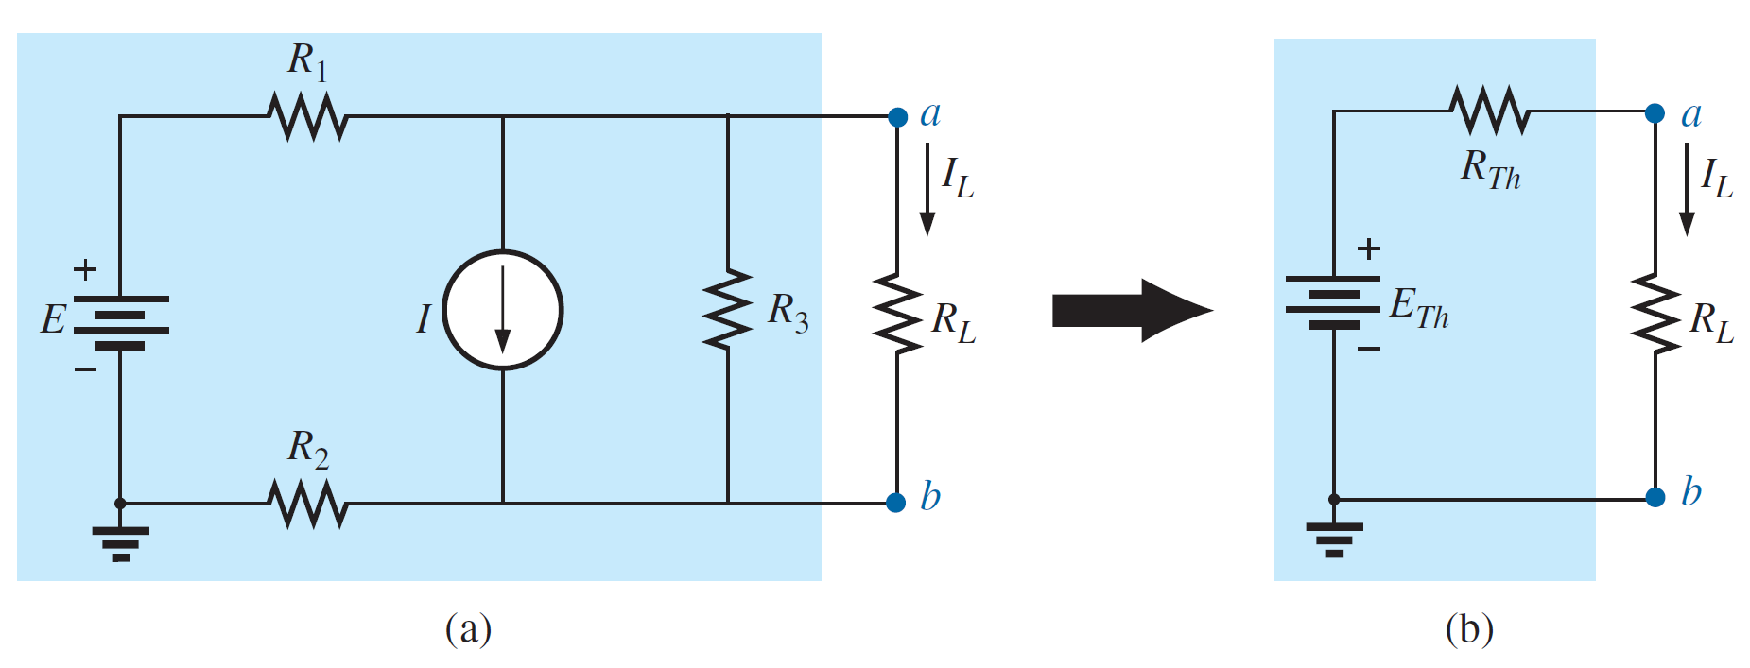
Thevenin's Theorem

Slide 4
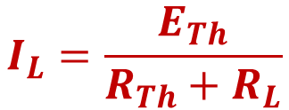
Thevenin's Theorem
$$I_{L}=\frac{E_{Th}}{R_{Th}+R_{L}}$$

Slide 5
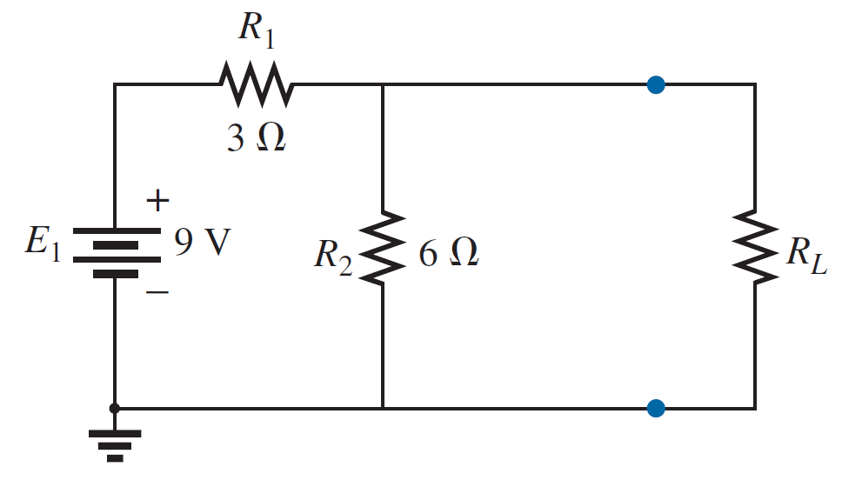

Thevenin's Theorem
Thevenin's Theorem Procedure
EXAMPLE 1: Find the Thevenin equivalent circuit. Then find the current through R_{L} for the circuit of figure.
$$R_{L}=10Ω$$

Slide 6
Thevenin's Theorem
Thevenin's Theorem Procedure
EXAMPLE 1: Find the Thevenin equivalent circuit. Then find the current through R_{L} for the circuit of figure.
Step 1:- Remove that portion of the network where the Thevenin equivalent circuit is found. In Figure below, this requires that the load resistor R_{L} be temporarily removed from the network.
$$R_{L}=10Ω$$

Slide 7
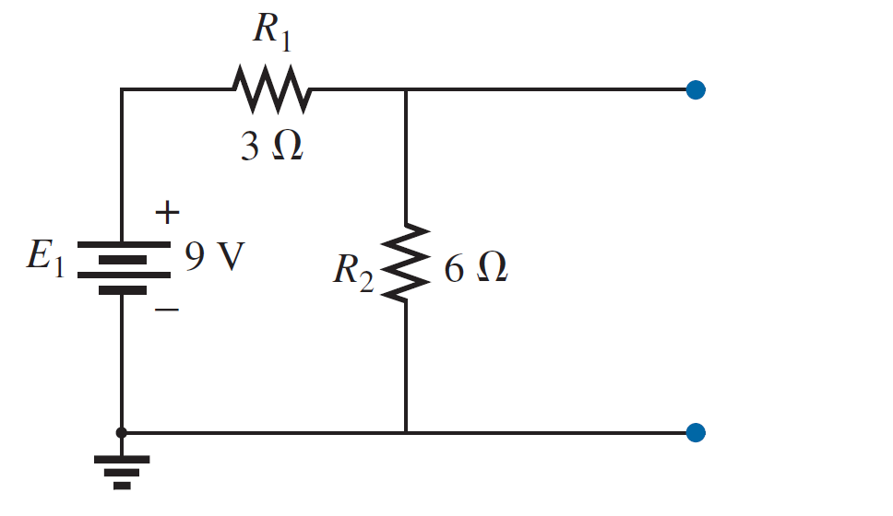
Thevenin's Theorem
Thevenin's Theorem Procedure
EXAMPLE 1: Find the Thevenin equivalent circuit. Then find the current through R_{L} for the circuit of figure.
Step 1:- Remove that portion of the network where the Thevenin equivalent circuit is found. In Figure below, this requires that the load resistor R_{L} be temporarily removed from the network.

Slide 8
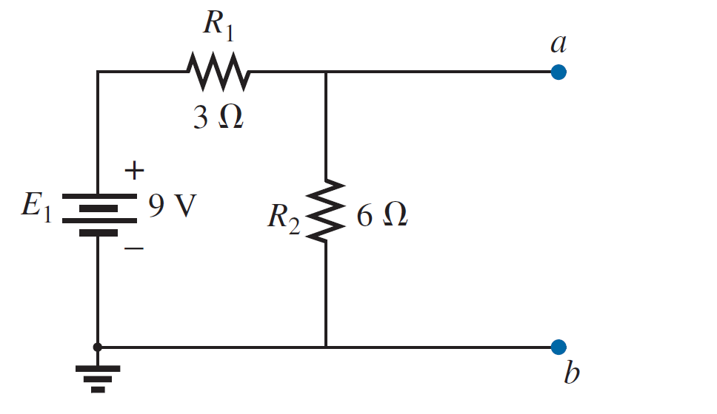
Thevenin's Theorem
Thevenin's Theorem Procedure
EXAMPLE 1: Find the Thevenin equivalent circuit. Then find the current through R_{L} for the circuit of figure.
Step 2:- Mark the terminals of the remaining two-terminal network. (The importance of this step will become obvious as we progress through some complex networks.)

Slide 9
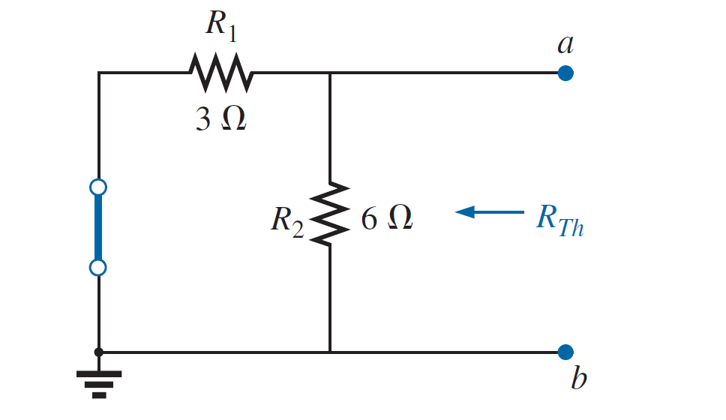

Thevenin's Theorem
Thevenin's Theorem Procedure
EXAMPLE 1: Find the Thevenin equivalent circuit. Then find the current through R_{L} for the circuit of figure.
Step 3:-Calculate R_{Th} by first setting all sources to zero (voltage sources are replaced by short circuits, and current sources by open circuits) and then finding the resultant resistance between the two marked terminals.

Slide 10
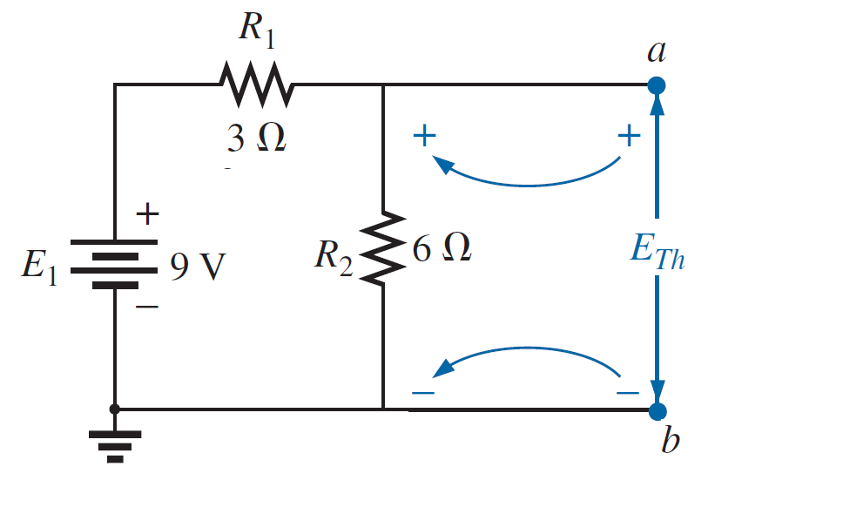
Thevenin's Theorem
Thevenin's Theorem Procedure
EXAMPLE 1: Find the Thevenin equivalent circuit. Then find the current through R_{L} for the circuit of figure.
Step 4:-Calculate E_{Th} by first returning all sources to their original position and finding the open-circuit voltage between the marked terminals.

Slide 11
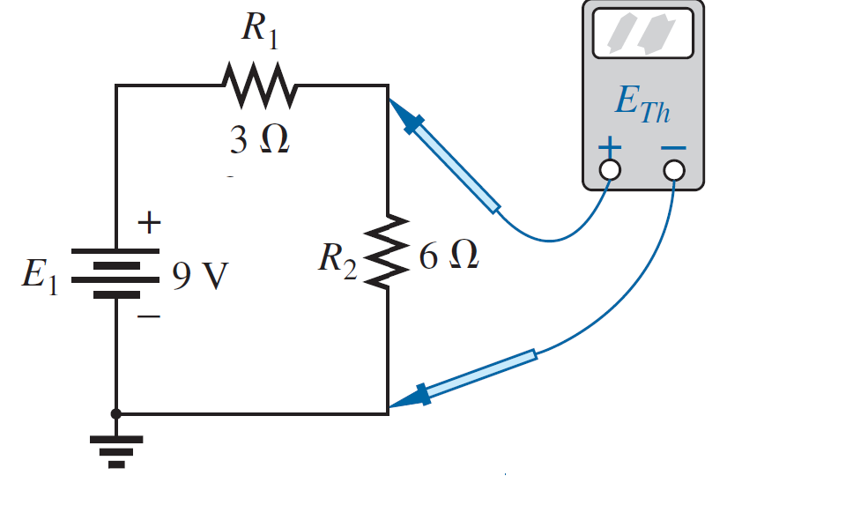

Thevenin's Theorem
Thevenin's Theorem Procedure
EXAMPLE 1: Find the Thevenin equivalent circuit. Then find the current through R_{L} for the circuit of figure.
Step 4:-Calculate E_{Th} by first returning all sources to their original position and finding the open-circuit voltage between the marked terminals.
For this case, the open circuit voltage E_{Th} is the same as the voltage drop across the 6 Ω resistor.
Applying the voltage divider rule,

Slide 12
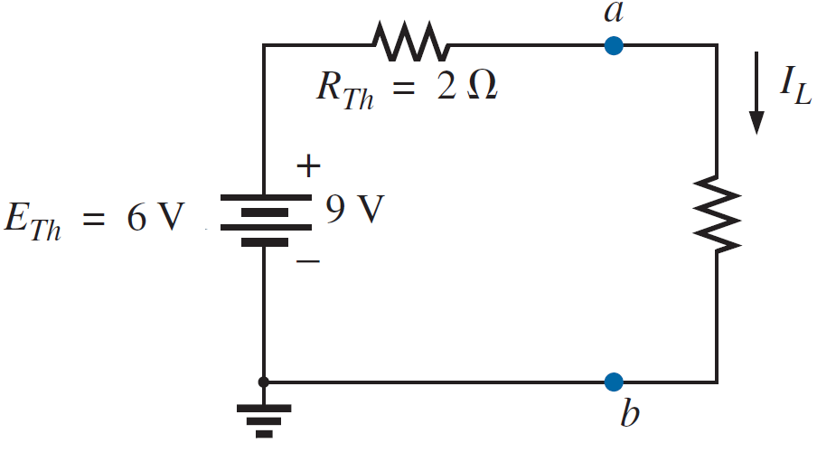

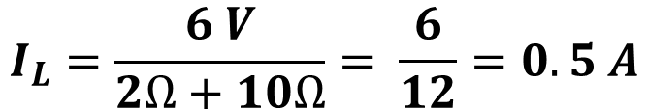

Thevenin's Theorem
Thevenin's Theorem Procedure
EXAMPLE 1: Find the Thevenin equivalent circuit. Then find the current through R_{L} for the circuit of figure.
Step 5:-Draw the Thevenin equivalent circuit with the portion of the circuit previously removed replaced between the terminals of the equivalent circuit.
$$I_{L}=\frac{E_{Th}}{R_{Th}+R_{L}}$$
$$R_{L}=10Ω$$
$$I_{L}=\frac{6 V}{2Ω+10Ω}= \frac{6}{12}=0.5 A$$

Slide 13
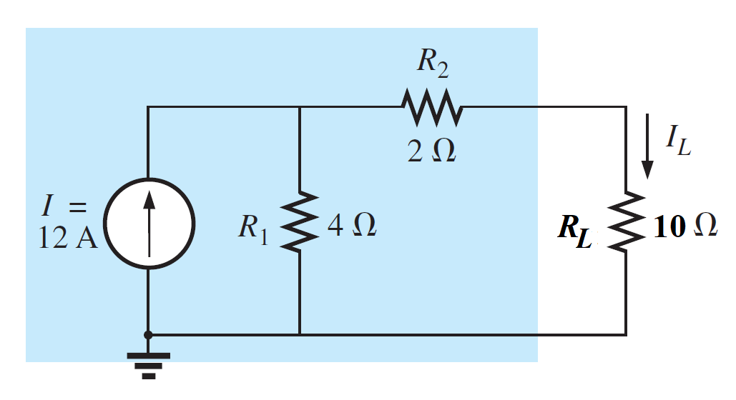
Thevenin's Theorem
EXAMPLE 2: Find the Thevenin equivalent circuit. Then find the current through R_{L} for the circuit of figure.

Slide 14
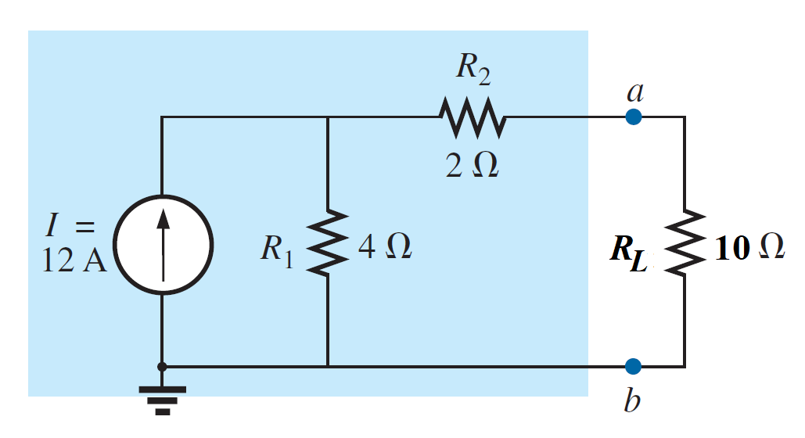
Thevenin's Theorem
EXAMPLE 2: Find the Thevenin equivalent circuit. Then find the current through R_{L} for the circuit of figure.
Solution:-
Step 1 and 2:-

Slide 15
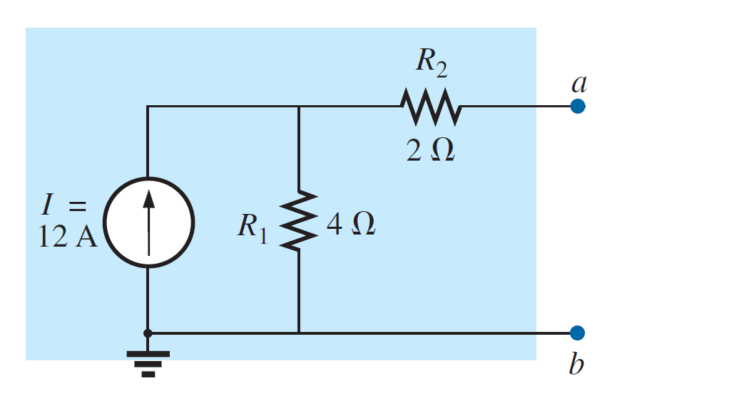
Thevenin's Theorem
EXAMPLE 2: Find the Thevenin equivalent circuit. Then find the current through R_{L} for the circuit of figure.
Solution:-
Step 1 and 2:-

Slide 16
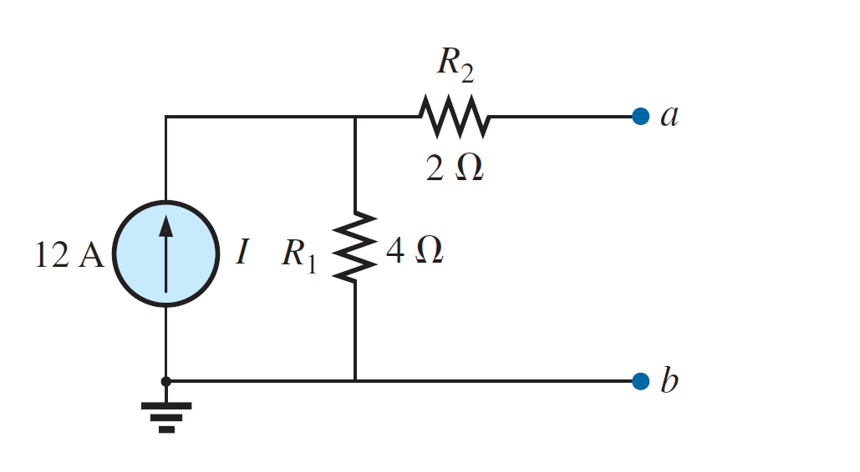
Thevenin's Theorem
EXAMPLE 2: Find the Thevenin equivalent circuit. Then find the current through R_{L} for the circuit of figure.
Solution:-
Step 1 and 2:-

Slide 17
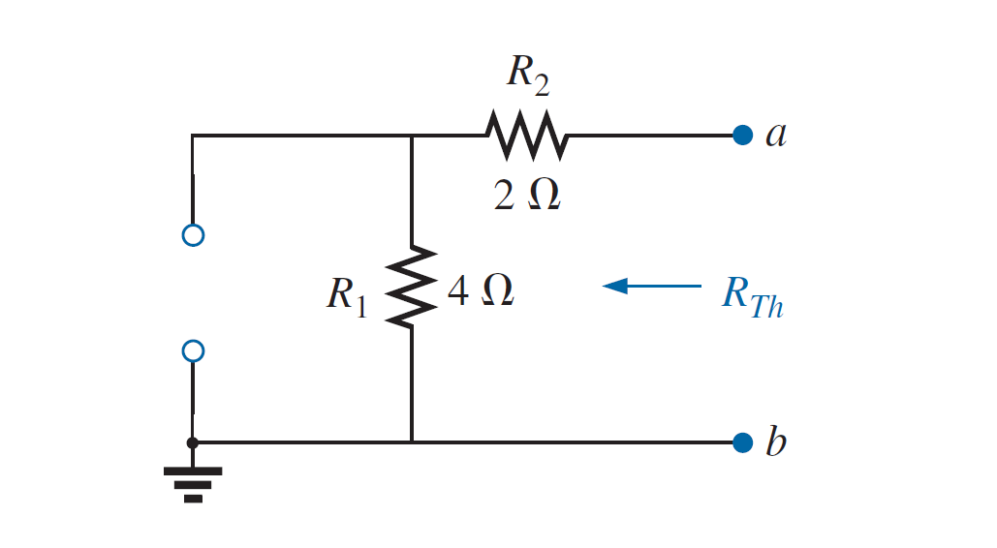

Thevenin's Theorem
EXAMPLE 2: Find the Thevenin equivalent circuit. Then find the current through R_{L} for the circuit of figure.
Solution:-
Step 3:-

Slide 18
Thevenin's Theorem
EXAMPLE 2: Find the Thevenin equivalent circuit. Then find the current through R_{L} for the circuit of figure.
Solution:-
Step 4:-

Slide 19
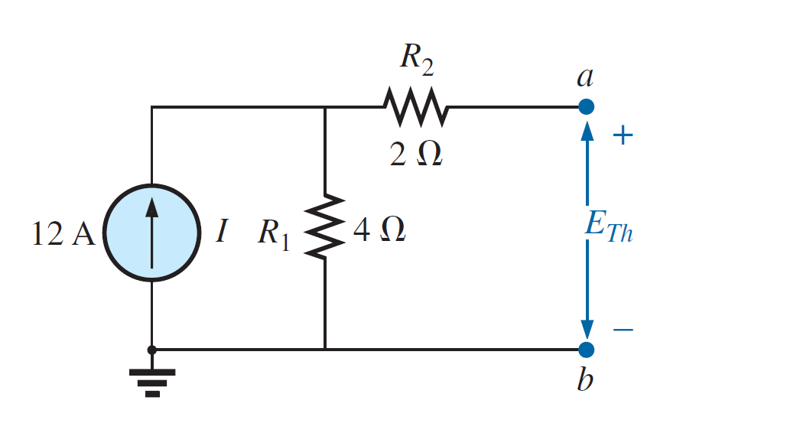
Thevenin's Theorem
EXAMPLE 2: Find the Thevenin equivalent circuit. Then find the current through R_{L} for the circuit of figure.
Solution:-
Step 4:-

Slide 20

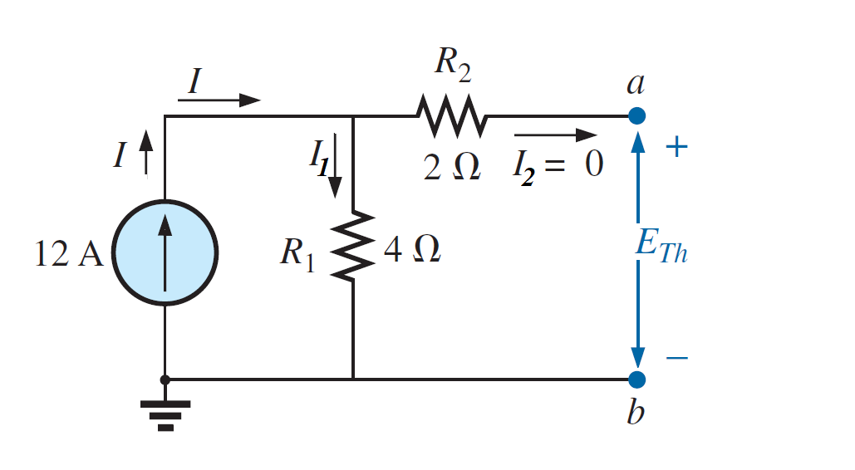
Thevenin's Theorem
EXAMPLE 2: Find the Thevenin equivalent circuit. Then find the current through R_{L} for the circuit of figure.
Solution:-
Step 4:-

Slide 21
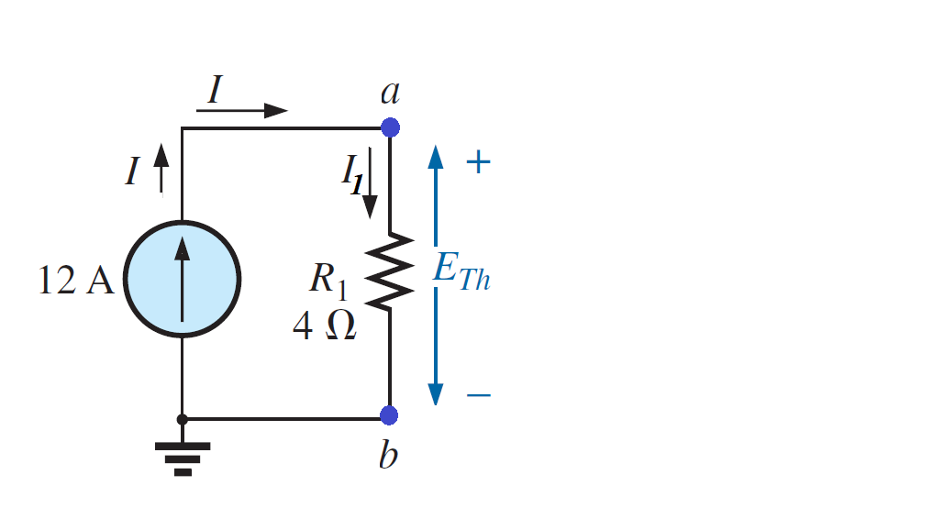
Thevenin's Theorem
EXAMPLE 2: Find the Thevenin equivalent circuit. Then find the current through R_{L} for the circuit of figure.
Solution:-
Step 4:-

Slide 22



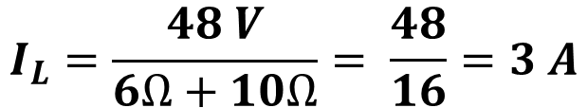
Thevenin's Theorem
EXAMPLE 2: Find the Thevenin equivalent circuit. Then find the current through R_{L} for the circuit of figure.
Solution:-
Step 5:-
$$R_{Th}=6Ω$$
$$I_{L}=\frac{E_{Th}}{R_{Th}+R_{L}}$$
$$E_{Th}=48V$$
$$R_{L}=10Ω$$
$$I_{L}=\frac{48 V}{6Ω+10Ω}= \frac{48}{16}=3 A$$

Slide 23
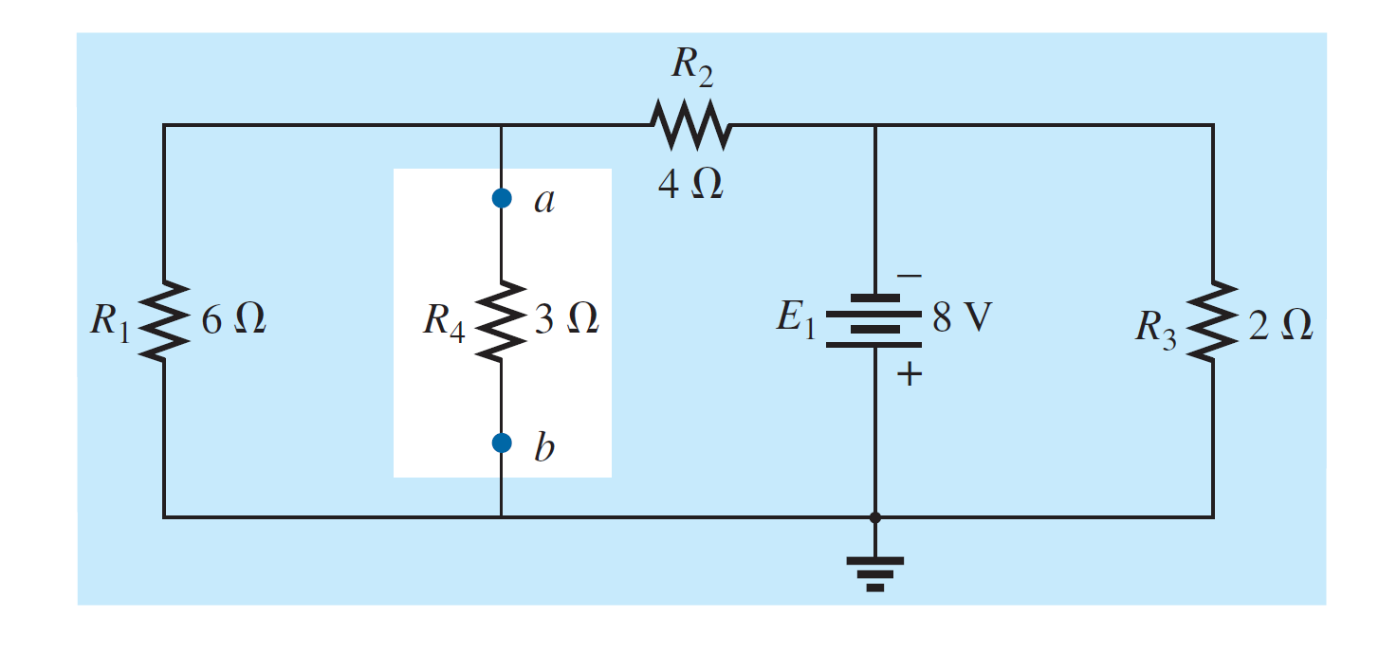
Thevenin's Theorem
EXAMPLE 3: Find the Thevenin equivalent circuit. Then find the current through 3 Ω resistor for the circuit of figure.

Slide 24
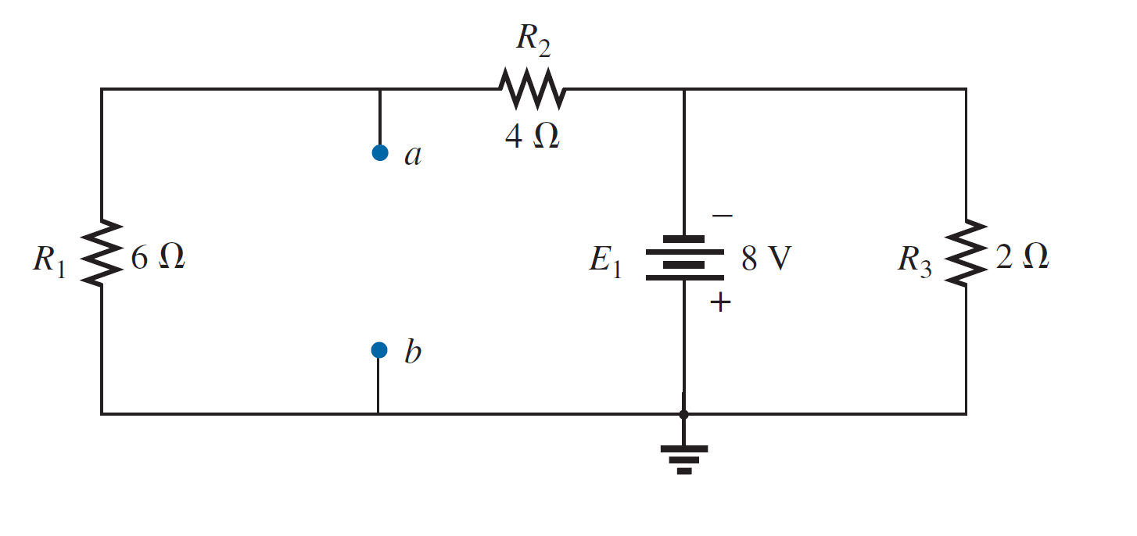
Thevenin's Theorem
EXAMPLE 3: Find the Thevenin equivalent circuit. Then find the current through 3 Ω resistor for the circuit of figure.
Solution:-
Step 1 and 2:-

Slide 25
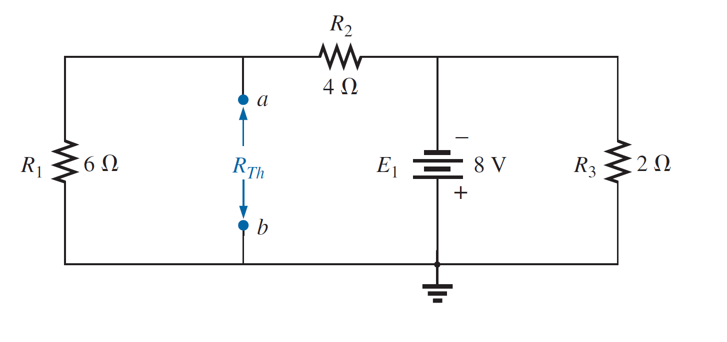
Thevenin's Theorem
EXAMPLE 3: Find the Thevenin equivalent circuit. Then find the current through 3 Ω resistor for the circuit of figure.
Solution:-
Step 3:-

Slide 26
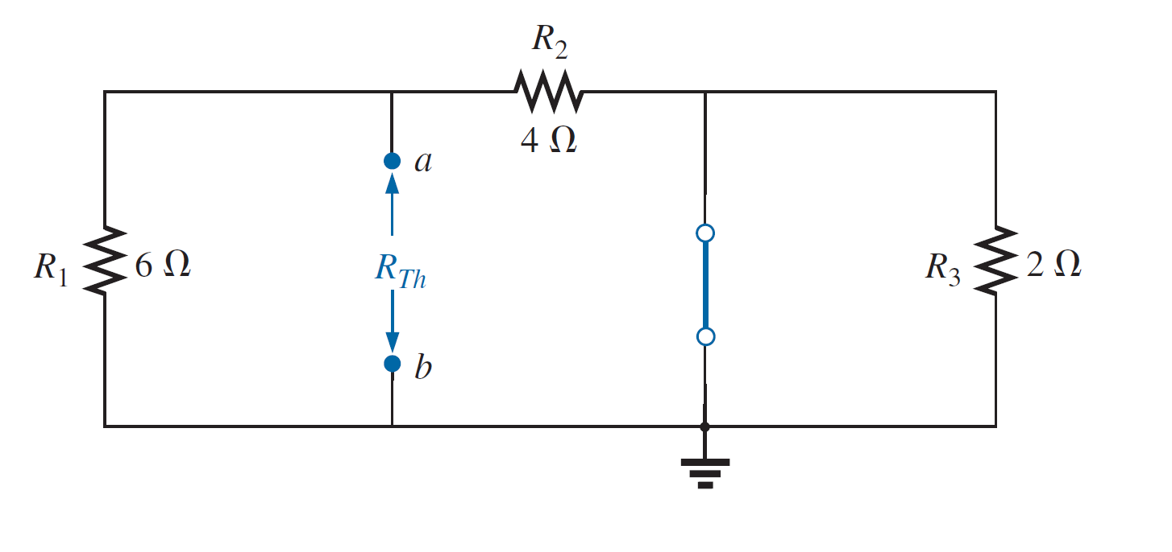
Thevenin's Theorem
EXAMPLE 3: Find the Thevenin equivalent circuit. Then find the current through 3 Ω resistor for the circuit of figure.
Solution:-
Step 3:-

Slide 27
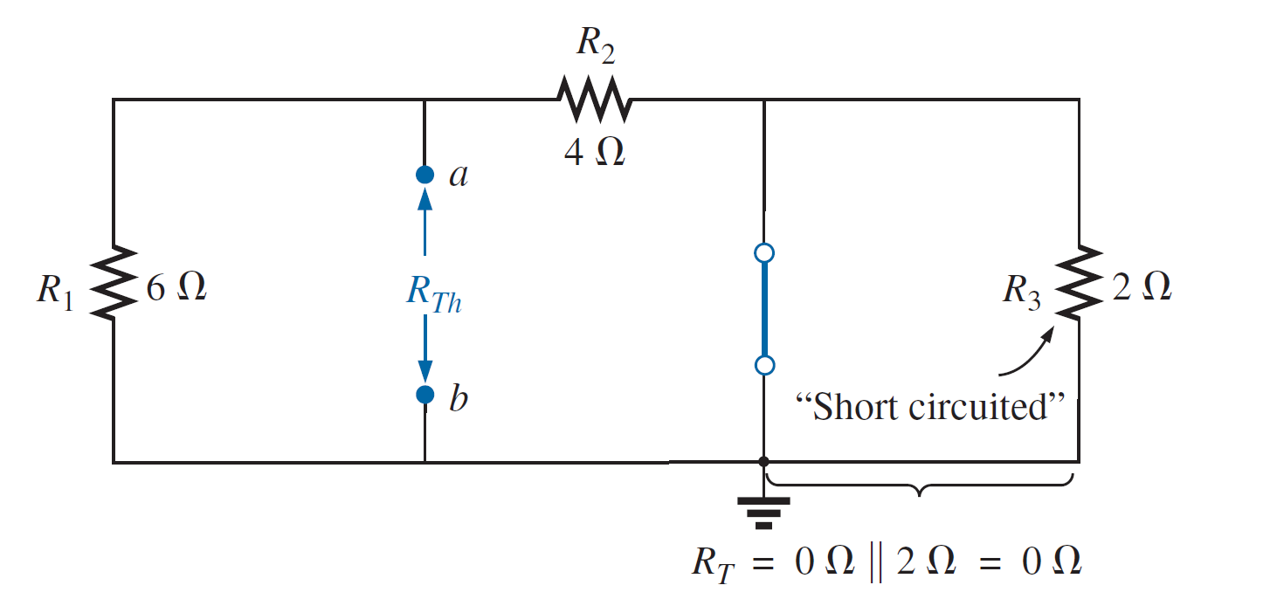
Thevenin's Theorem
EXAMPLE 3: Find the Thevenin equivalent circuit. Then find the current through 3 Ω resistor for the circuit of figure.
Solution:-
Step 3:-

Slide 28
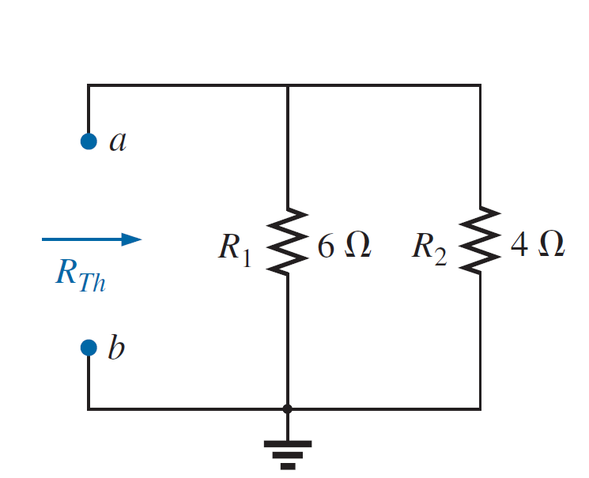

Thevenin's Theorem
EXAMPLE 3: Find the Thevenin equivalent circuit. Then find the current through 3 Ω resistor for the circuit of figure.
Solution:-
Step 3:-

Slide 29
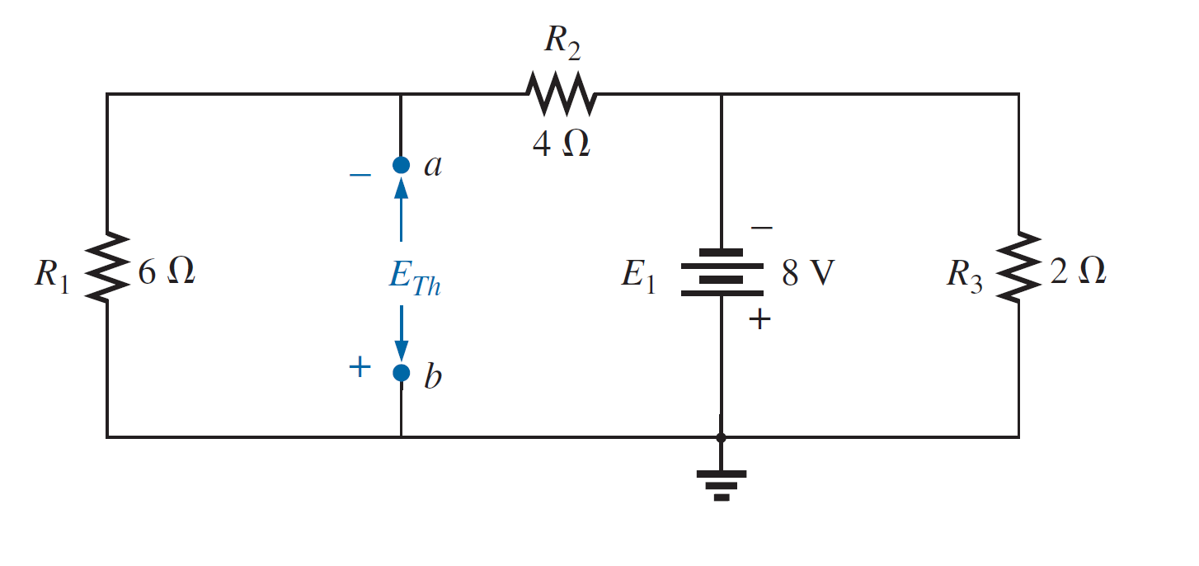
Thevenin's Theorem
EXAMPLE 3: Find the Thevenin equivalent circuit. Then find the current through 3 Ω resistor for the circuit of figure.
Solution:-
Step 4:-

Slide 30
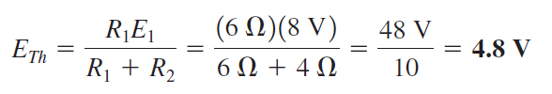
Thevenin's Theorem
EXAMPLE 3: Find the Thevenin equivalent circuit. Then find the current through 3 Ω resistor for the circuit of figure.
Solution:-
Step 4:-
Applying the voltage divider rule,

Slide 31
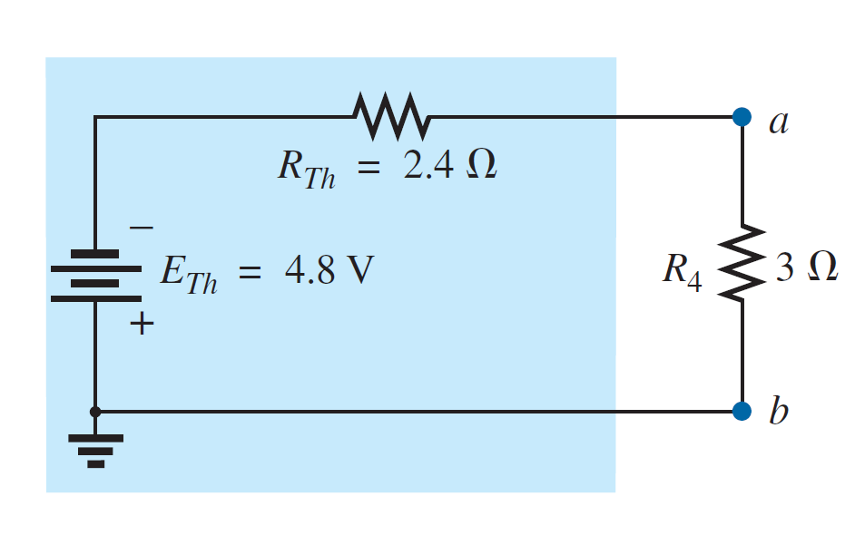
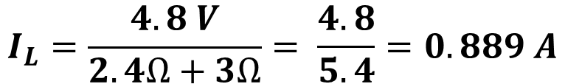
Thevenin's Theorem
EXAMPLE 3: Find the Thevenin equivalent circuit. Then find the current through 3 Ω resistor for the circuit of figure.
Solution:-
Step 5:-
$$I_{L}=\frac{E_{Th}}{R_{Th}+R_{L}}$$
$$I_{L}=\frac{4.8 V}{2.4Ω+3Ω}= \frac{4.8}{5.4}=0.889 A$$

